Slide 1
ASSIGNMENT 3 DISCRIMINANT STATISTICS (DATA 2204)
Oluwaseyi Babalola - 100808940

Slide 2
Rational Statement
Mr. John Hughes has asked us to carry out an analysis on a dataset to predict if an individual is happy or unhappy. To do this, we would utilize certain factors including; Availability of information about city services, Housing costs, Quality of public education, Trust in law enforcement, Maintenance of infrastructure, and Access to community services
To do this, we would be using the Linear and Quadratic variants of Discriminant Analysis (LDA & QDA) to divide the dataset into Happy or Unhappy (Which are mutually exclusive), based on the factors stated above.
We would also compare the results gotten when they’re optimized and give Mr. John Hughes the most suitable recommendations for the next steps.

Slide 3
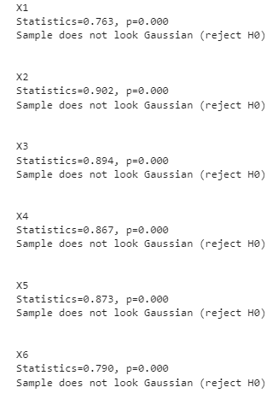
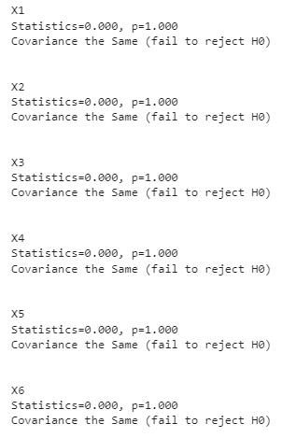


assumptions
Discriminant models run on the assumptions that:
There is Multivariate Normality for the independent variables. However, Figure X shows that the assumption was violated for all variables.
There is Homogeneity of Covariance across all the independent variables. Figure O shows no violations of this assumption.
BÖKEOĞLU ÇOKLUK, Ö, & BÜYÜKÖZTÜRK, Ş. (2008)

Slide 4
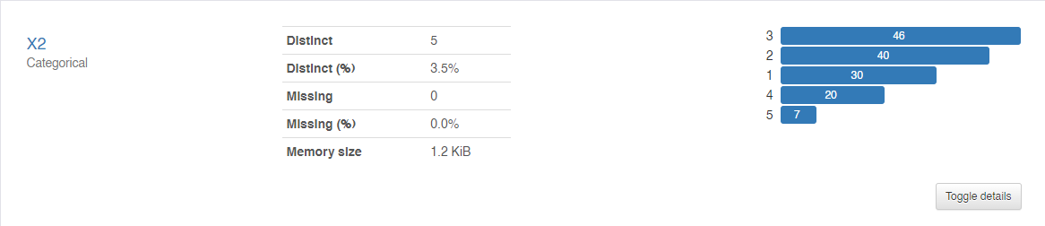
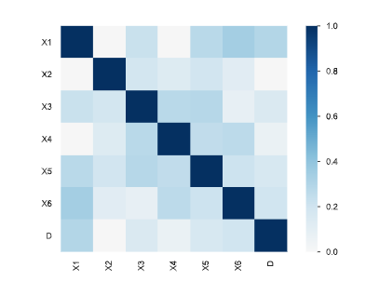
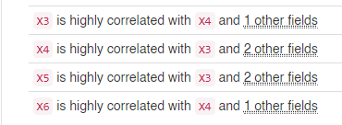
Insights from profile report
Normality: The image on the right shows the distribution of the observations for the X2 variable which also mirrors the other independent variables. This gives further credence to the fact that they are not normally distributed, as there is skewness.
Multicollinearity: The Heat map shows some relationship between the variables, but the profile report's alert rubber stamps that fact and shows which variables are correlated with the other.

Slide 5
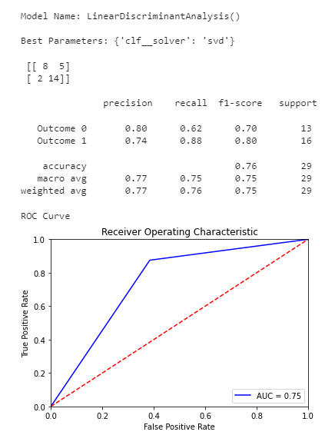
Optimized Linear discriminant analysis (LDA) metrics
Precision: The model has performed just okay, making correct predictions of the state of happiness of respondents 77% of the time
Recall: When the model has predicted outcomes of happiness or unhappiness, It is correct 76% of the time
F1 Score: The weighted average between the model’s accurate predictions (Precision) and its correct positive predictions stands at 75%. This is the most relevant metric of note seeing as the outcomes are not perfectly balanced.
This is further reiterated by the Area under the curve which is also 75%

Slide 6
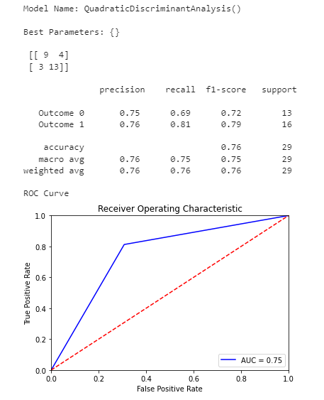
Optimized quadratic discriminant analysis (qda) metrics
Balance: The use of SMOTE to try the tune the parameters to achieve balance yielded 13 for Outcome 0, and 16 for Outcome 1. While this is not a perfect balance, its still good enough to proceed with the model.
Recall: When the model has attempted to predict positive outcomes of happiness or unhappiness, It is correct 76% of the time
F1 Score: The weighted average between the model’s accurate predictions (Precision) and its correct positive predictions stands at 76%. This is the most relevant metric of note seeing as the outcomes are not perfectly balanced.

Slide 7
Comparing LDA and QDA
Typically, when the dataset is not balanced, F1 Score is the best metric to evaluate the model. Despite the use of smote, the support column shows the balance is not perfect. Thus, QDA’s F1 score of 76% means its slightly more favorable than the LDA which stands at 75%.
Both models performed with the same level of accuracy, producing accurate predictions 76% of the time.
The QDA is more flexible in the assumption of an equal covariance among the classes, unlike the LDA that is strict with this.

Slide 8
Recommendations to Mr. John Hughes
Since the F1 Score for the QDA, then it should be chosen more favorably ahead of the LDA.
There was a clear violation of the assumption of normality of distribution from which each class is drawn. Despite fairly good performances by the two models, it might be better to use a model that does not work with this assumption. Like the Support Vector Machines.

